Slide 1
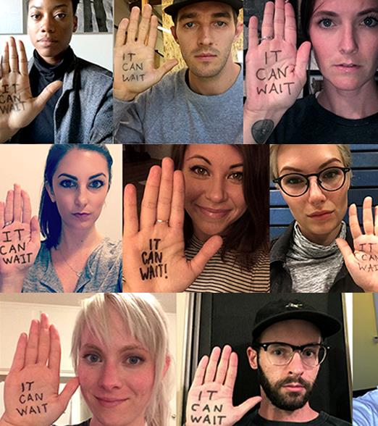

It Can Wait®
School Presentation
INSERT YOUR LOGO HERE THEN
DELETE BOX.
ENTER YOUR TITLE HERE
ENTER THE DATE
© 2021 AT&T Intellectual Property. AT&T, Globe logo, and DIRECTV are registered trademarks and service marks of
AT&T Intellectual Property and/or AT&T affiliated companies. All other marks are the property of their respective owners

Slide 2


Raise your hand if any of the following apply to you:
I sometimes text, check social media, or change music on my phone while I’m driving.
I check my phone at a red light.
I sometimes see my parents or friends using their phone while they drive.
I expect a response from friends within minutes of sending them a message (even if they might be driving).
Notes:
Note: Slides 2-4 guide an open conversation the presenter can have with the school-aged audience.

Slide 3

Why do we use our phones while driving?
I don’t really,
I only read
notifications.
I’m at a red light, so it’s fine. I’m in control.
I sometimes
get bored.
I need to coordinate time-sensitive plans with my friends!
That ding…
It could be an emergency..
I’m actually
really good at it.
Notes:
Note: Slides 2-4 guide an open conversation the presenter can have with the school-aged audience.

Slide 4

HOW MANY PEOPLE THINK USING A PHONE BEHIND THE WHEEL IS DANGEROUS?
Notes:
Note: Slides 2-4 guide an open conversation the presenter can have with the school-aged audience.

Slide 5
95
%
VIEW DISTRACTED DRIVING AS A PROBLEM¹
¹ Online survey with 603 respondents (total distracted drivers n=489) conducted by Kantar Added Value. Data represented here were collected October 2019-December 2019. National panel sample (ages 15-54, drive, and have a smartphone).
Notes:
95% of people view distracted driving as a problem, and more than a third of drivers call it a habit.¹

Slide 6
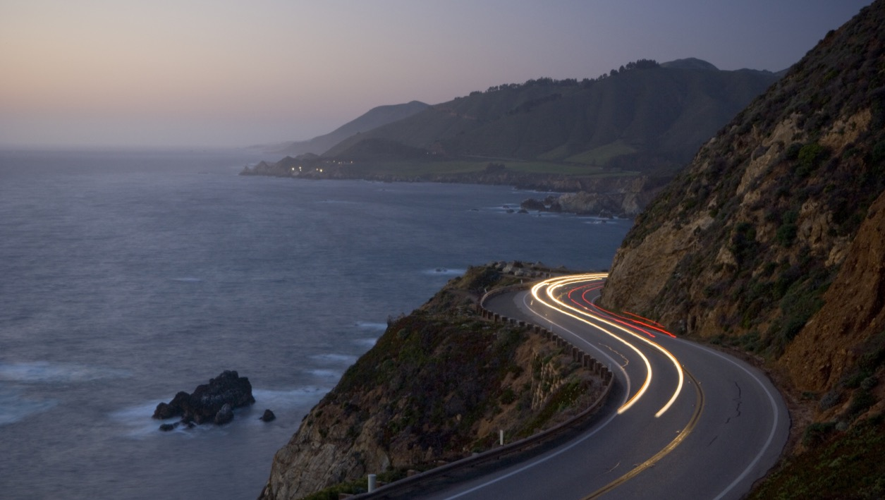
OVER 75%
OF 15-24 YEARS OLDS DRIVE DISTRACTED AT LEAST ONCE A MONTH¹
¹ Online survey with 603 respondents (total distracted drivers n=489) conducted by Kantar Added Value. Data represented here were collected October 2019-December 2019. National panel sample (ages 15-54, drive, and have a smartphone).
Notes:
However, challenges remain.

Slide 7










Tens of thousands of people are injured — and hundreds die — every year due to smartphone distracted driving. ¹
75%
  Using GPS
  on their phone ²
68%
  Read texts, emails
  or social media ²
67%
  Choose music to play ²
60%
  Write texts, emails
  or social media posts ²
54%
  Surf the web ²
53%
  View websites ²
54%
  Watch videos/
  view pictures ²
52%
  Take pictures/
  record video ²
40%
  Use video chat apps ²
38%
  Play games ²
¹ U.S. Department of Transportation National Highway Traffic Safety Administration, Distracted Driving 2018 (Traffic Safety Facts Research Note, April 2020, Table 2 & Table 4)
² Online survey with 603 respondents (total distracted drivers n=489) conducted by Kantar Added Value. Data represented here were collected October 2019-December 2019. National panel sample (ages 15-54, drive, and have a smartphone).
Notes:
Distracted driving is dangerous. People report that they text, play music, snap/view photos, email, view social media, surf the net and watch/stream videos while driving.

Slide 8
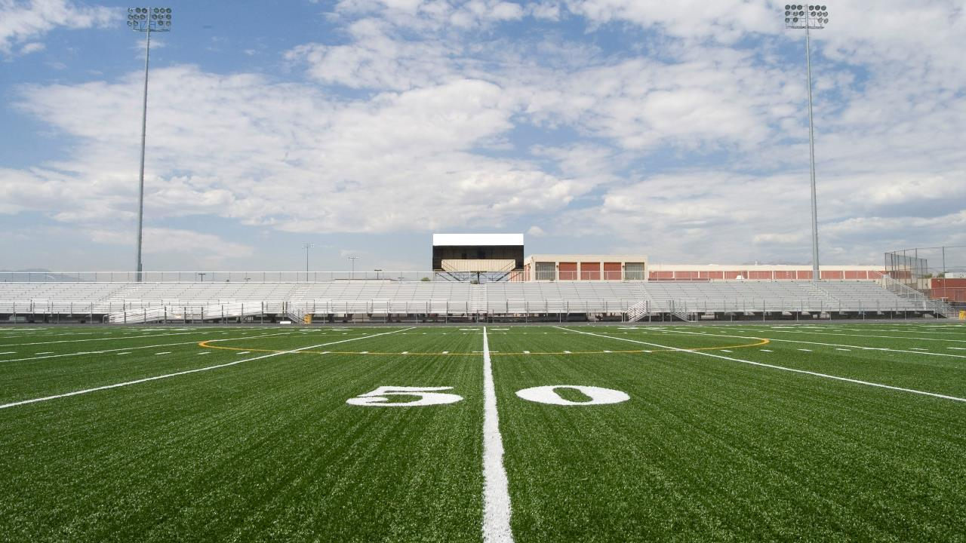
CHECKING YOUR PHONE FOR 5 SECONDS WHILE DRIVING 55MPH IS LIKE DRIVING THE LENGTH OF A FOOTBALL FIELD BLINDFOLDED
Notes:
Because let's remember: Checking your phone for 5 seconds while driving 55mph is like driving the length of a football field blindfolded. That’s dangerous.

Slide 9
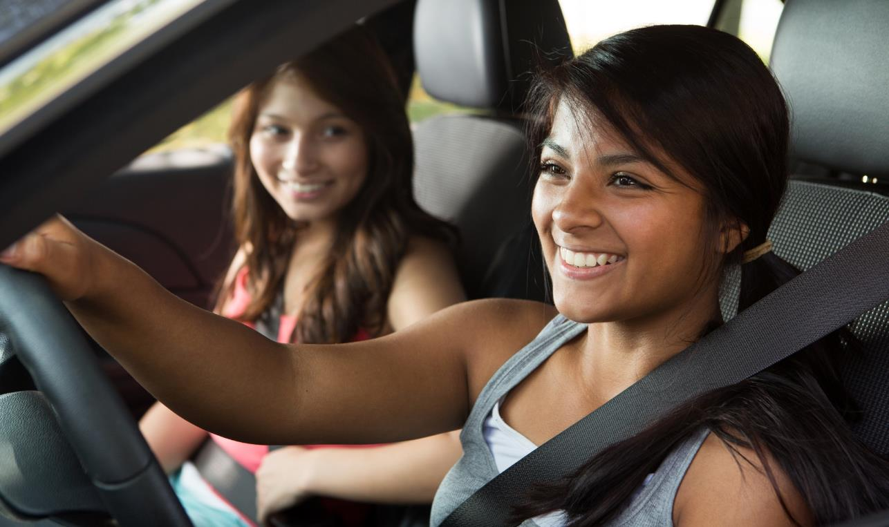

WHAT CAN
YOU DO TO
MAKE A
CHANGE?
Notes:
So what can you do to make a change?

Slide 10
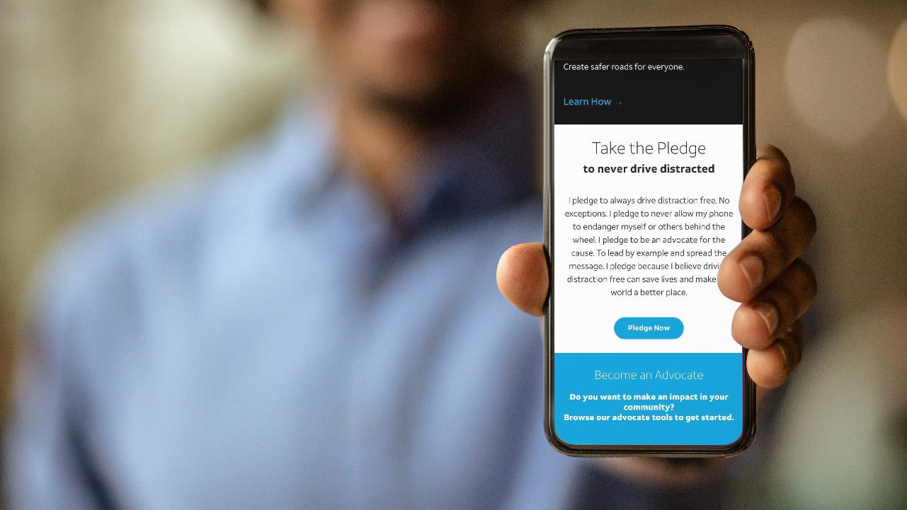
TAKE THE PLEDGE
…to never drive distracted at ItCanWait.com!
Notes:
The It Can Wait Pledge: “I pledge to always drive distraction free. I pledge to never allow my phone to endanger myself or others behind the wheel. I pledge to lead by example and spread the message. I pledge because I believe driving distraction free can save lives and make the world a better place.”
Activity 1: Take the pledge…like right now! Get out your phones/computers and go to It Can Wait Dot Com.
OR
Activity 2: Raise your hand if you agree to take the pledge.

Slide 11
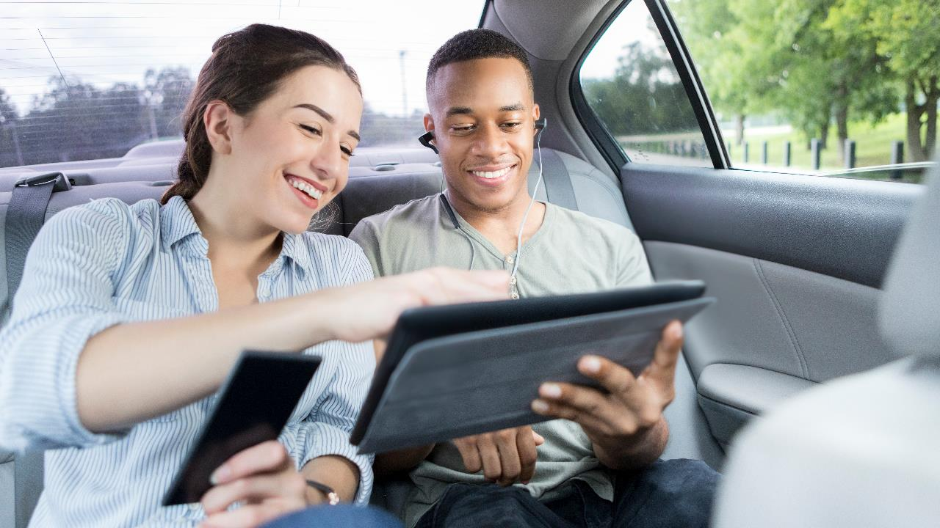
SPEAK UP
People are just waiting for someone to tell them to stop.
Notes:
57% of people are more likely to stop driving distracted if a friend or passenger pressures them to.* That means over half of people are just waiting for someone to tell them to stop. So the best way to create distraction free roads is to speak up. It’s time to feel that we have the right and the responsibility to speak up about distracted driving.
Activity on how to speak up: Show the string of videos on ItCanWait.com under Ice Breakers (links below as well) and then have them practice with someone in the audience.
You can also ask questions of the audience: Which ice breakers are you most likely to use? Do you think some would be more effective with your friends and why? What other ice breakers can you think of?
FULL SET: https://www.youtube.com/watch?v=dc1nnT4ZGDo
Be Direct https://youtu.be/OdgO8G56XT0
Offer to Help https://youtu.be/rKcENrl9dBM
Share the Facts https://youtu.be/CINrORL_XLQ
Show Some Love https://youtu.be/LrlhnIc4FNg
Take a Stand https://youtu.be/Fco4tkPp2Jo
*Online survey with 603 respondents (total distracted drivers n=489) conducted by Kantar Added Value. Data represented here were collected October 2019-December 2019. National panel sample (ages 15-54, drive, and have a smartphone)

Slide 12
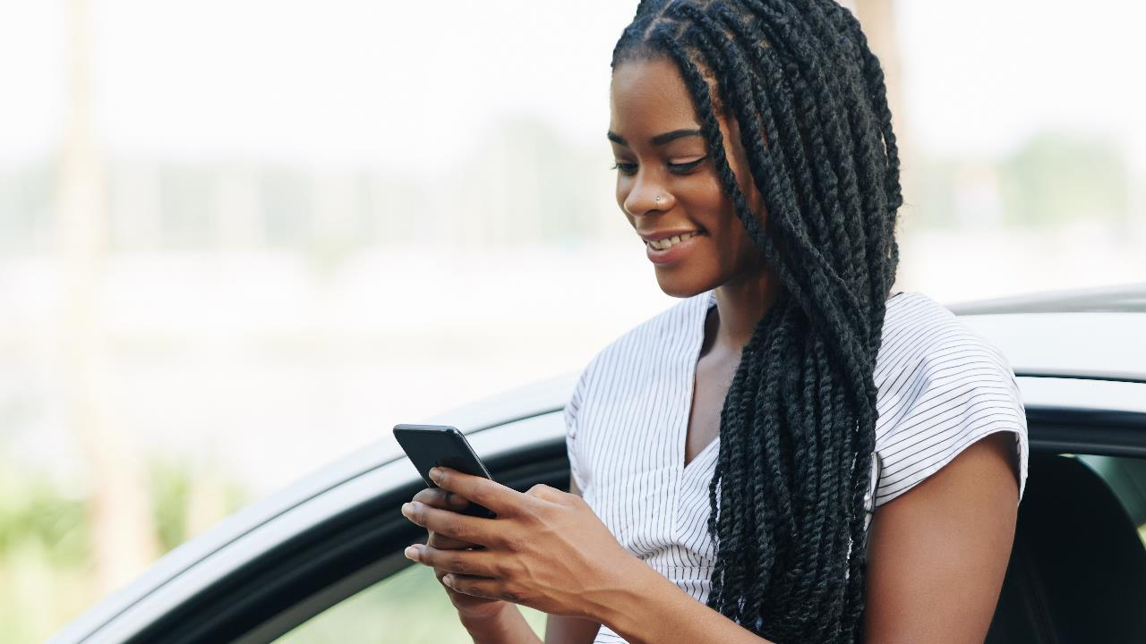
JOIN THE MOVEMENT
You can help raise awareness in your community.
Notes:
Join the movement and help make an impact. Raise awareness in your community and put an end to distracted driving.
Activity: Show the string of videos on ItCanWait.com under Tips (links below as well) and then ask questions of the audience: Which tips are you most likely to use? Do you think some would be more effective for you and why? What other tips can you think of?
FULL SET: https://www.youtube.com/watch?v=QgC6AXTOkws
If it’s that Important, Pull Over https://youtu.be/cCqzoZ24JVk
Use Your Car’s Voice Controls https://youtu.be/n78ojenK3Kc
Give Your Phone to a Passenger https://youtu.be/NIz_lcOfb8M
Keep Your Phone on Silent https://youtu.be/FB8C0XdtK2s
Use Your Phone Before You Go https://youtu.be/TURQ5An0-u4

Slide 13
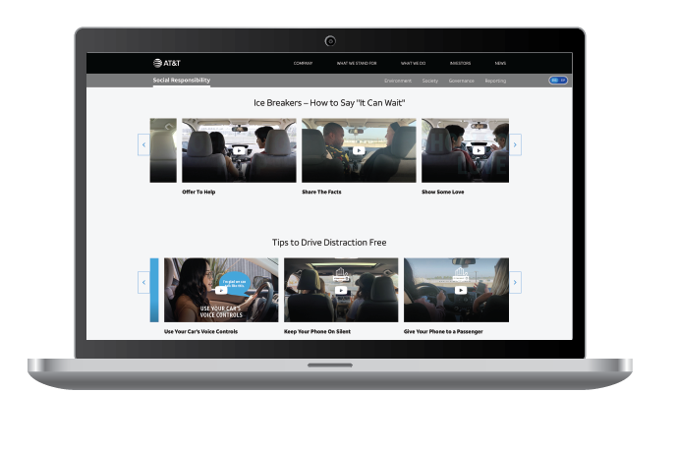
Summary: Take Action and Join the Movement
TAKE THE PLEDGE
Take the It at ItCanWait.com. Can Wait Pledge to drive distraction free
SPEAK UP
Use the Ice Breakers on ItCanWait.com to speak up and help prevent distracted driving.
JOIN THE MOVEMENT
  Find tips and other resources at ItCanWait.com to help raise awareness and put an end to distracted driving in your community.
Notes:
Take three easy steps:
Take the pledge to drive distraction free to create safer roads for everyone.
Speak up — no matter the distraction — to help reduce distracted driving.
Join the movement: On ItCanWait.com, everyone can find free resources to speak up and help prevent distracted driving. From real stories from real people impacted by distracted driving, to conversations starters with family and friends, to presentations to give in your community.

Slide 14
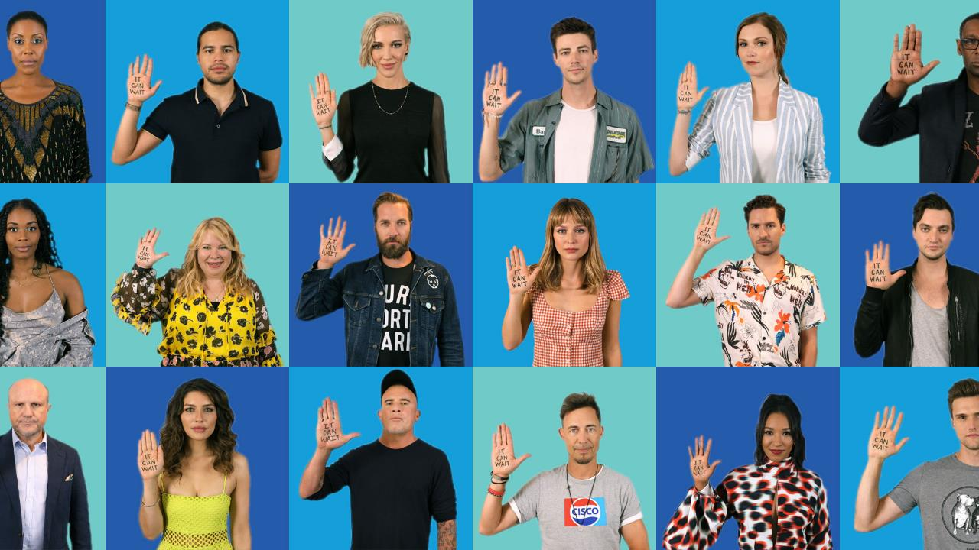
Speak up — no matter the distraction — and pledge yourself and others to never do it again.
Since 2010, It Can Wait has generated more than 40M pledges to never drive distracted. AT&T is committed to making this behavior ancient history.
Notes:
We know most people think distracted driving is wrong, dangerous, and a major problem. The only thing holding us back…is us! When you’re behind the wheel – It Can Wait!

Slide 15
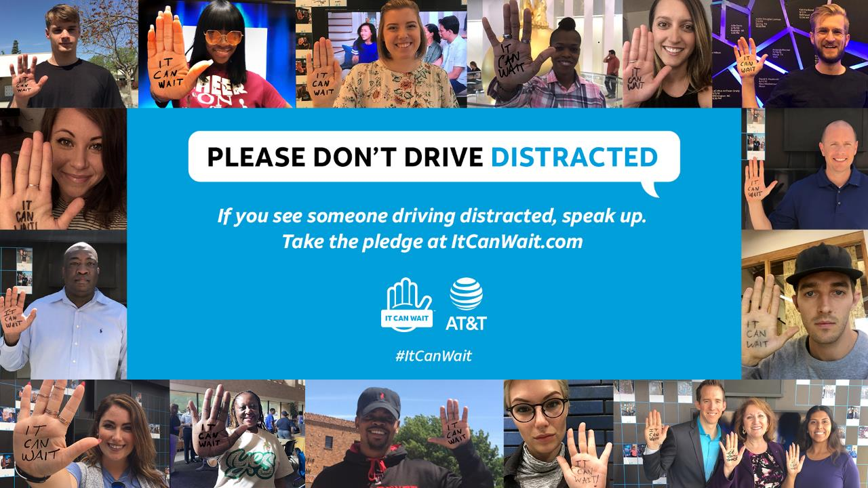

Notes:
Make a difference in your community. Join AT&T and commit to making this habit ancient history today!

